Slide 1
MEME
MALL EXPERIENCE MADE EASY

Slide 2

TEAM MEMBERS
Charan Kasala
Kavya Sree Katakam
Keerthi Reddy Tummalapelly
Manojna Borra
Nikhitha Bijjala
Vamsi Krishna Changala

Slide 3
User Stories
S No | User Story | Task Assignment
1 | Login/Logout: As an admin, I should be able to login/ logout. | Keerthi Reddy Tummalapelly
2 | Registration: As a user, I should be able to register/ sign up. | Kavya Sree Katakam
3 | Login/Logout: As a user, I should be able to login/ logout. | Keerthi Reddy Tummalapelly
4 | Homepage: As a user, I must be able to view all the services | Nikhitha Bijjala
5 | Homepage: As a user, I must be able to access the services through hamburger menu | Charan Kasala
6 | As an admin, admin will be able to manage users | Nikhitha Bijjala

Slide 4
User Stories cont..
S No | User Story | Task Assignment
7 | User profile: As a User I must be able to view and update user profile | Charan Kasala
8 | Movie ticketing system: As an admin, I must be able to view/add/update/delete the movies | Manojna Borra
9 | Movie ticketing system: As a user, I must be able to view and filter the movies | Manojna Borra
10 | Movie ticketing system: As a user, I must be able to book a movie ticket | Keerthi Reddy Tummalapelly
11 | Movie ticketing system: As a user, I must be able to view a movie booking history | Nikhitha Bijjala
12 | Parking system: As an admin, I must be able to view/add/update/delete the parking lots and make a parking space available | Vamsi Krishna Changala

Slide 5
User Stories cont..
S No | User Story | Task Assignment
13 | Parking system: As a user, I must be able to view parking lots and parking spaces | Charan Kasala
14 | Parking system: As a user, I must be able to book a parking space in the selected parking lot | Vamsi Krishna Changala
15 | Parking system: As a user, I must be able to view Parking Booking History | Kavya sree Katakam
16 | Parking system: As an admin, I must be able to manage the booked parking space | Keerthi Reddy Tummalapelly
17 | Food Pre-order Service: As an admin, I should be able to view/add/update/delete the food stalls and food menu and manage food admins | Keerthi Reddy Tummalapelly

Slide 6
User Stories cont..
S No | User Story | Task Assignment
18 | Food Pre-order Service:: As an admin, I should be able to receive the order, accept/reject the order, send confirmation messages | Manojna Borra
19 | Food Pre-order Service:: As an food stall manager, I should be able to manage the food menu | Keerthi Reddy Tummalapelly
20 | Food Pre-order Service: As a user, I should be view all the food stalls and food menu | Charan Kasala
21 | Food Pre-order Service: As a user, I must be able to add the food items into cart and order the food. | Kavya Sree Katakam
22 | Food Pre-order Service: As a user, I must be able to view food booking history. | Kavya Sree Katakam

Slide 7
User Stories cont..
S No | User Story | Task Assignment
23 | Gaming zone: As an admin, I must be able to view/add/update/delete all the games and their details | Vamsi Krishna Changala
24 | Gaming zone: As a user, I must be able to view all the games and their details and be able to recharge my gaming card | Nikhitha Bijjala
25 | Shop specifics: As an admin, I must be able to view/add/update/delete all the stores in the mall and their details | Charan Kasala
26 | Shop specifics: As a user, I must be able to view all the stores in the mall and their details | Keerthi Reddy Tummalapelly
27 | Events: As an admin, I must be able to view/add/update/delete all the events happening in the mall | Kavya Sree Katakam

Slide 8
User Stories cont..
S No | User Story | Task Assignment
28 | Events: As a user, I must be able to view all the events in the mall and their details | Kavya Sree Katakam
29 | Flash deals: As an admin, I should be able to add/update/view/delete flash deals | Kavya Sree Katakam
30 | Flash Deals: As a user, I must be able to view all the flash and mega deals | Manojna Borra
31 | Job opportunities: As an admin, I must be able to view/add/update/delete job list | Nikhitha Bijjala
32 | Job opportunities: As an admin, I must be able to view the resume and accept/reject the job application | Nikhitha Bijjala

Slide 9
User Stories cont..
S No | User Story | Task Assignment
33 | Job opportunities: As a user, I must be able to view a job opportunities | Vamsi Krishna Changala
33 | Job opportunities: As a user, I must be able to apply to a job | Manojna Borra
34 | Job oppurtunities: As a user, I must be able to view the status of job applications | Vamsi Krishna Changala

Slide 10
Sprint 3 Retrospective
What went well? | What do we need to improve for the next time?
Together, we put in a lot of effort, collaborated well in the project with commitment. Each team member understood their duties and carried them out in accordance. Everyone has adequate time to fully consider and provide feedback on each other's contributions. Working on this project has helped us as a team learn a lot about web development as well as teamwork. | As a team, we encountered some problems integrating all of the code's components and also during deployment, but we were able to get beyond all of those challenges.

Slide 11
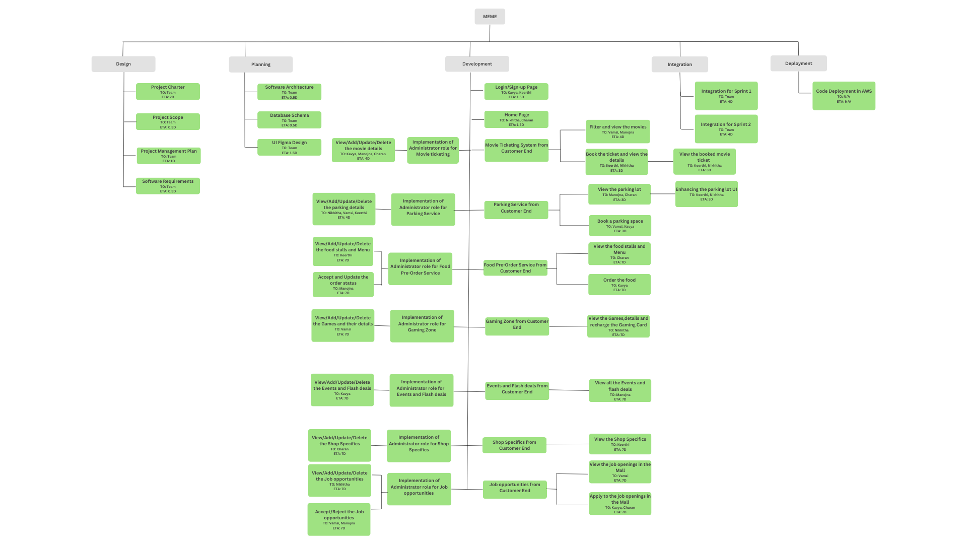
Work Breakdown Structure

Slide 12
THANK YOU

